Slide 1
Eight37 Lofts
Notes:
Change date as needed

Slide 2
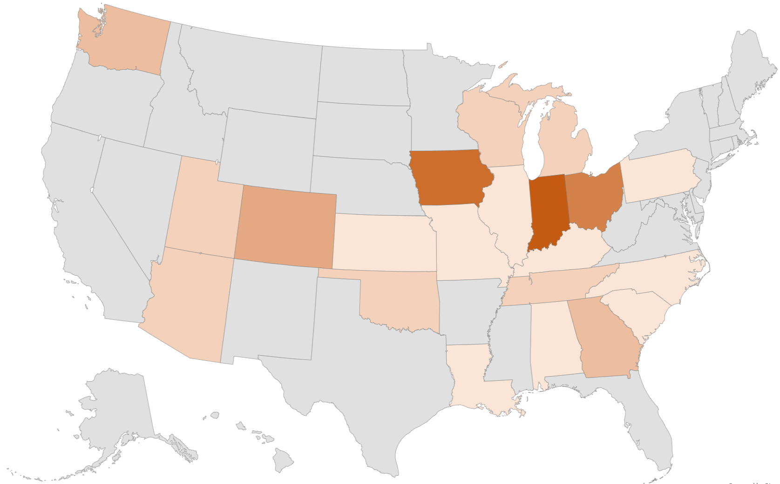
who We Are
Based in Indianapolis
Founded in 2007
Serve states across the country, but Indiana will always be our home base
Vertically Integrated
Concept to Stabilization
105+ Developments
$2B+ in Development Costs

Slide 3
Workforce Housing
What Workforce Housing is:
Households making 50%-60% of the Area Median Income (AMI)
Shelby County AMI Range: $33,850-$62,700
Residents often come from the following industries:
Health Care: Medical Assistants and Technicians
Retail/Hospitality: Casino Employees, Store Managers, etc.
Childcare & Education: Pre-K Instructors, Teachers, and Administrative Staff
Public Service: First Responders, Animal Control, Social Worker, etc.
As part of the state program, the following must occur for a person to lease a unit:
Income Verification
What Workforce Housing is Not:
Not Section 8 housing
Tenants pay their own rent
Background Check
Annual Recertifications
Funding comes from IHCDA, rather than HUD
General Factory & Warehouse Workers

Slide 4
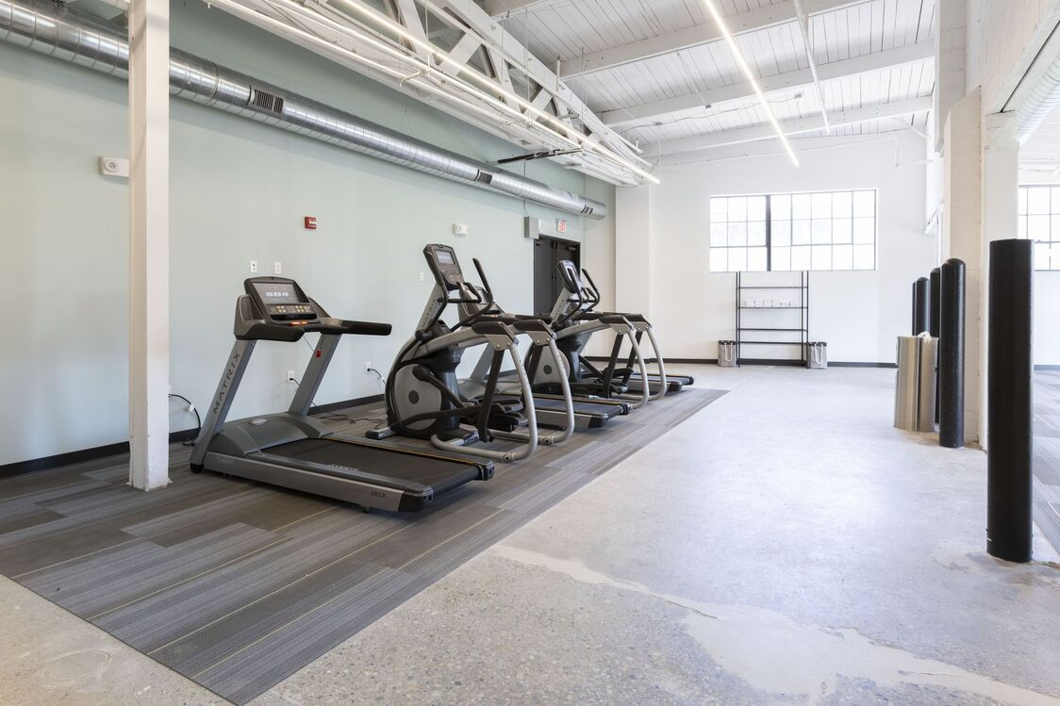
PAST Developments
The Assembly
WORKFORCE
Indianapolis, Indiana

Slide 5
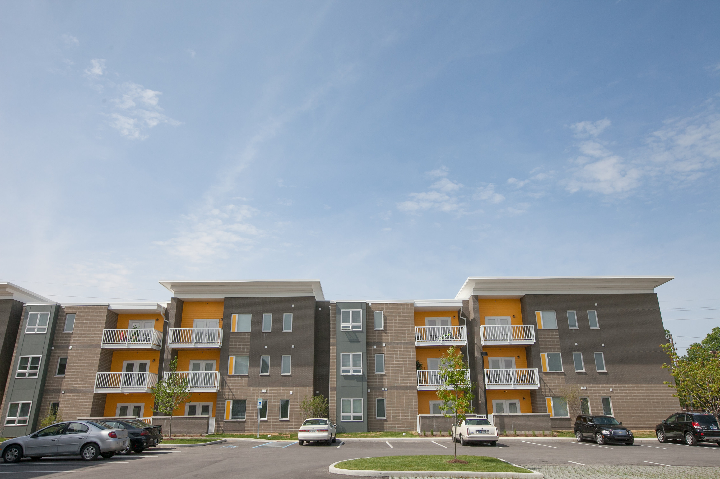
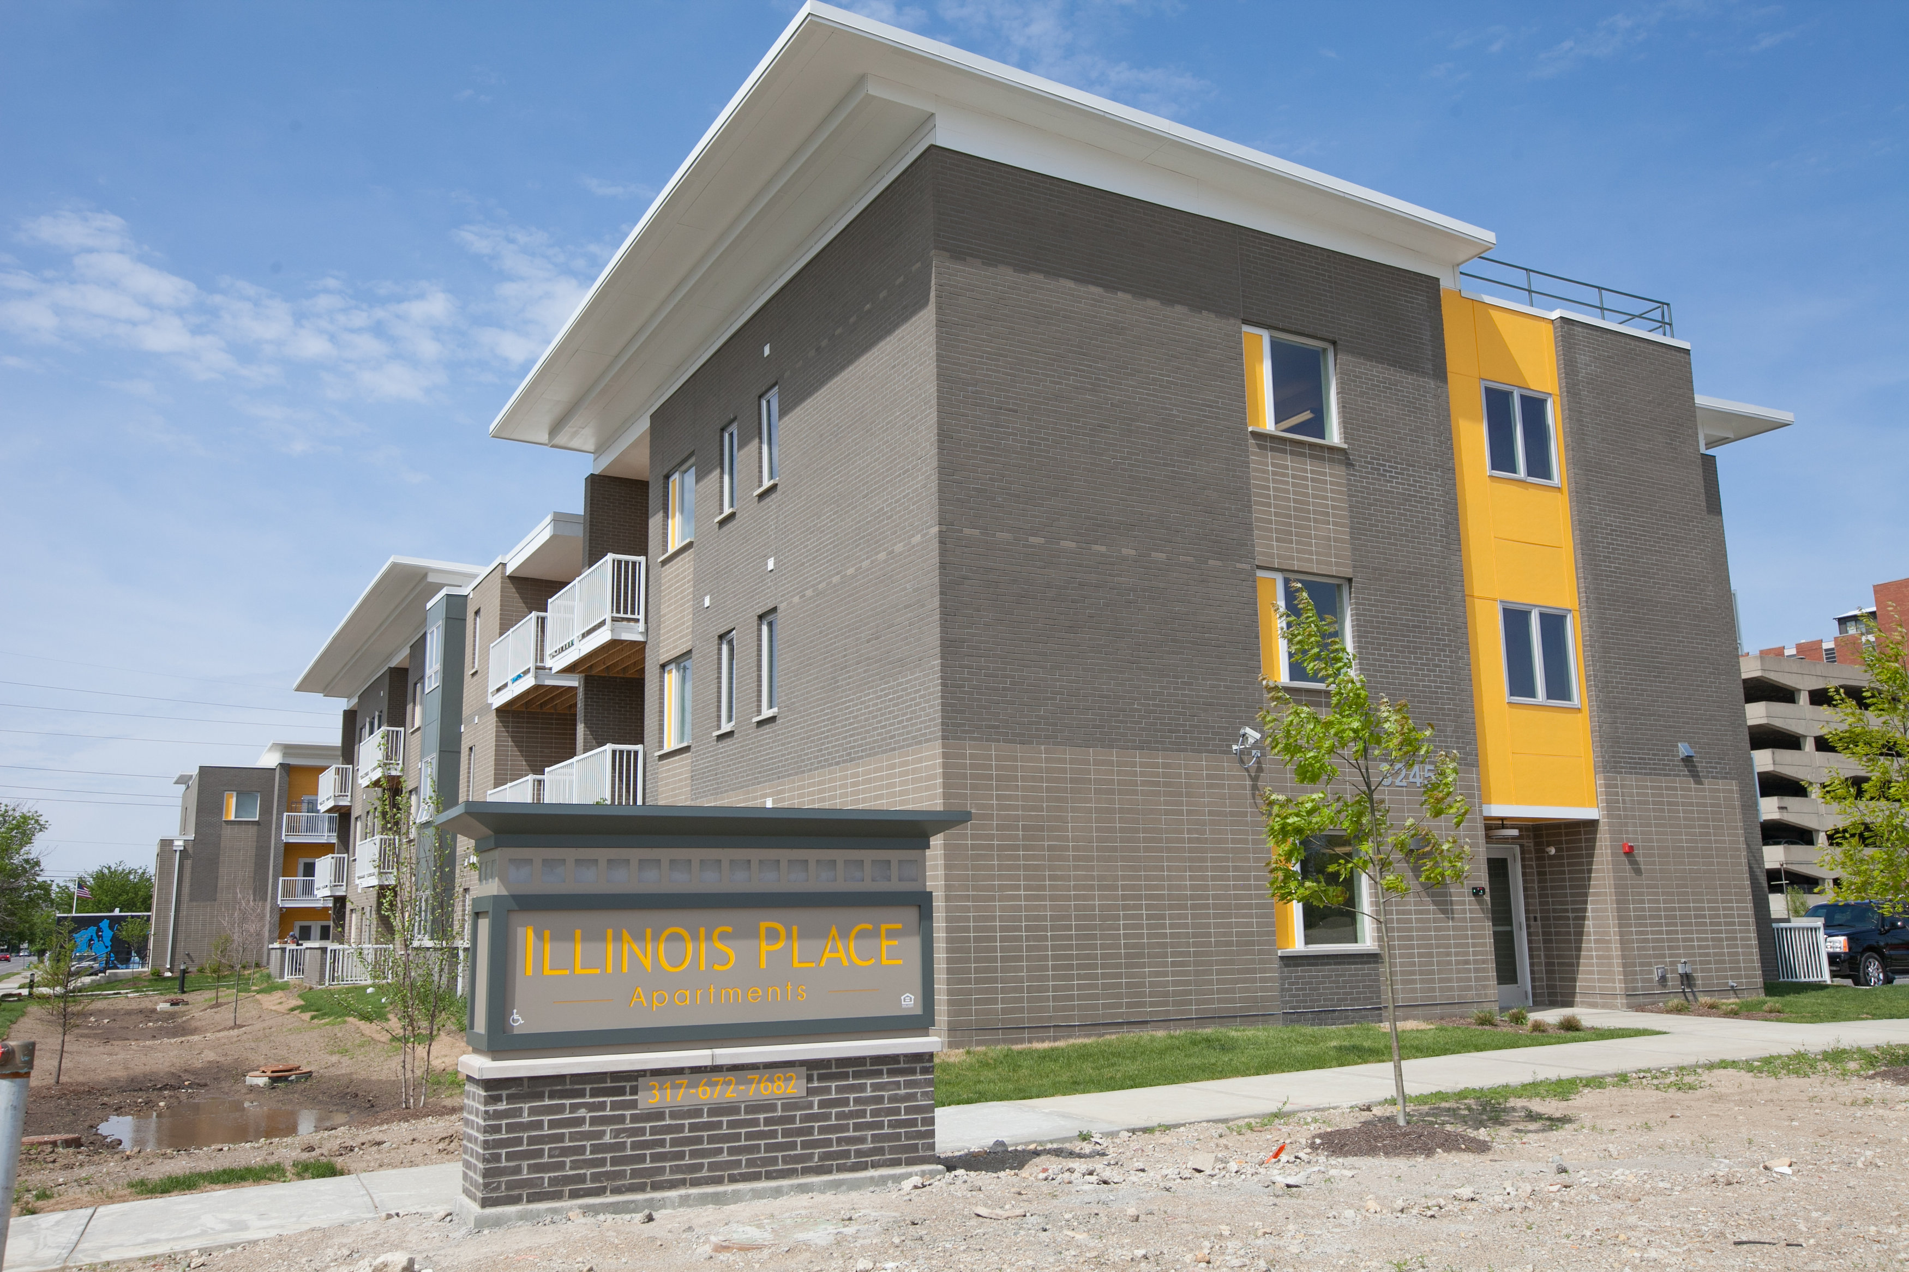
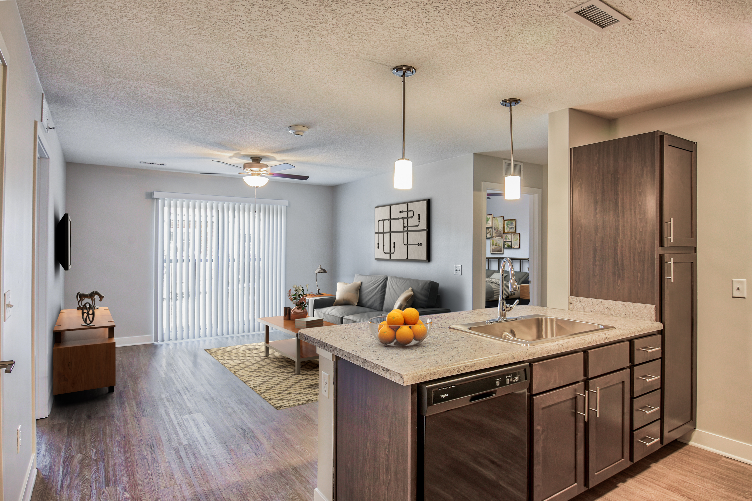
PAST Developments
Illinois Place
WORKFORCE
Indianapolis, Indiana

Slide 6
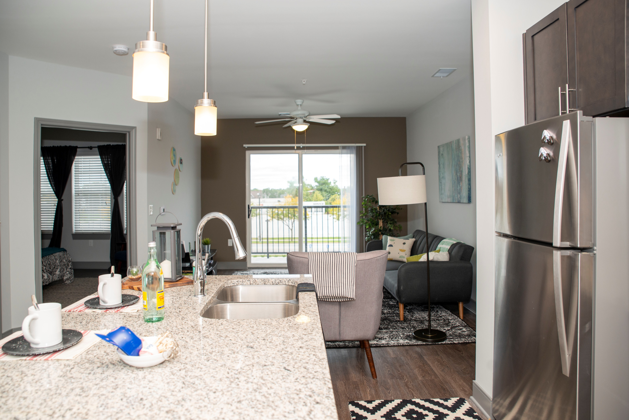
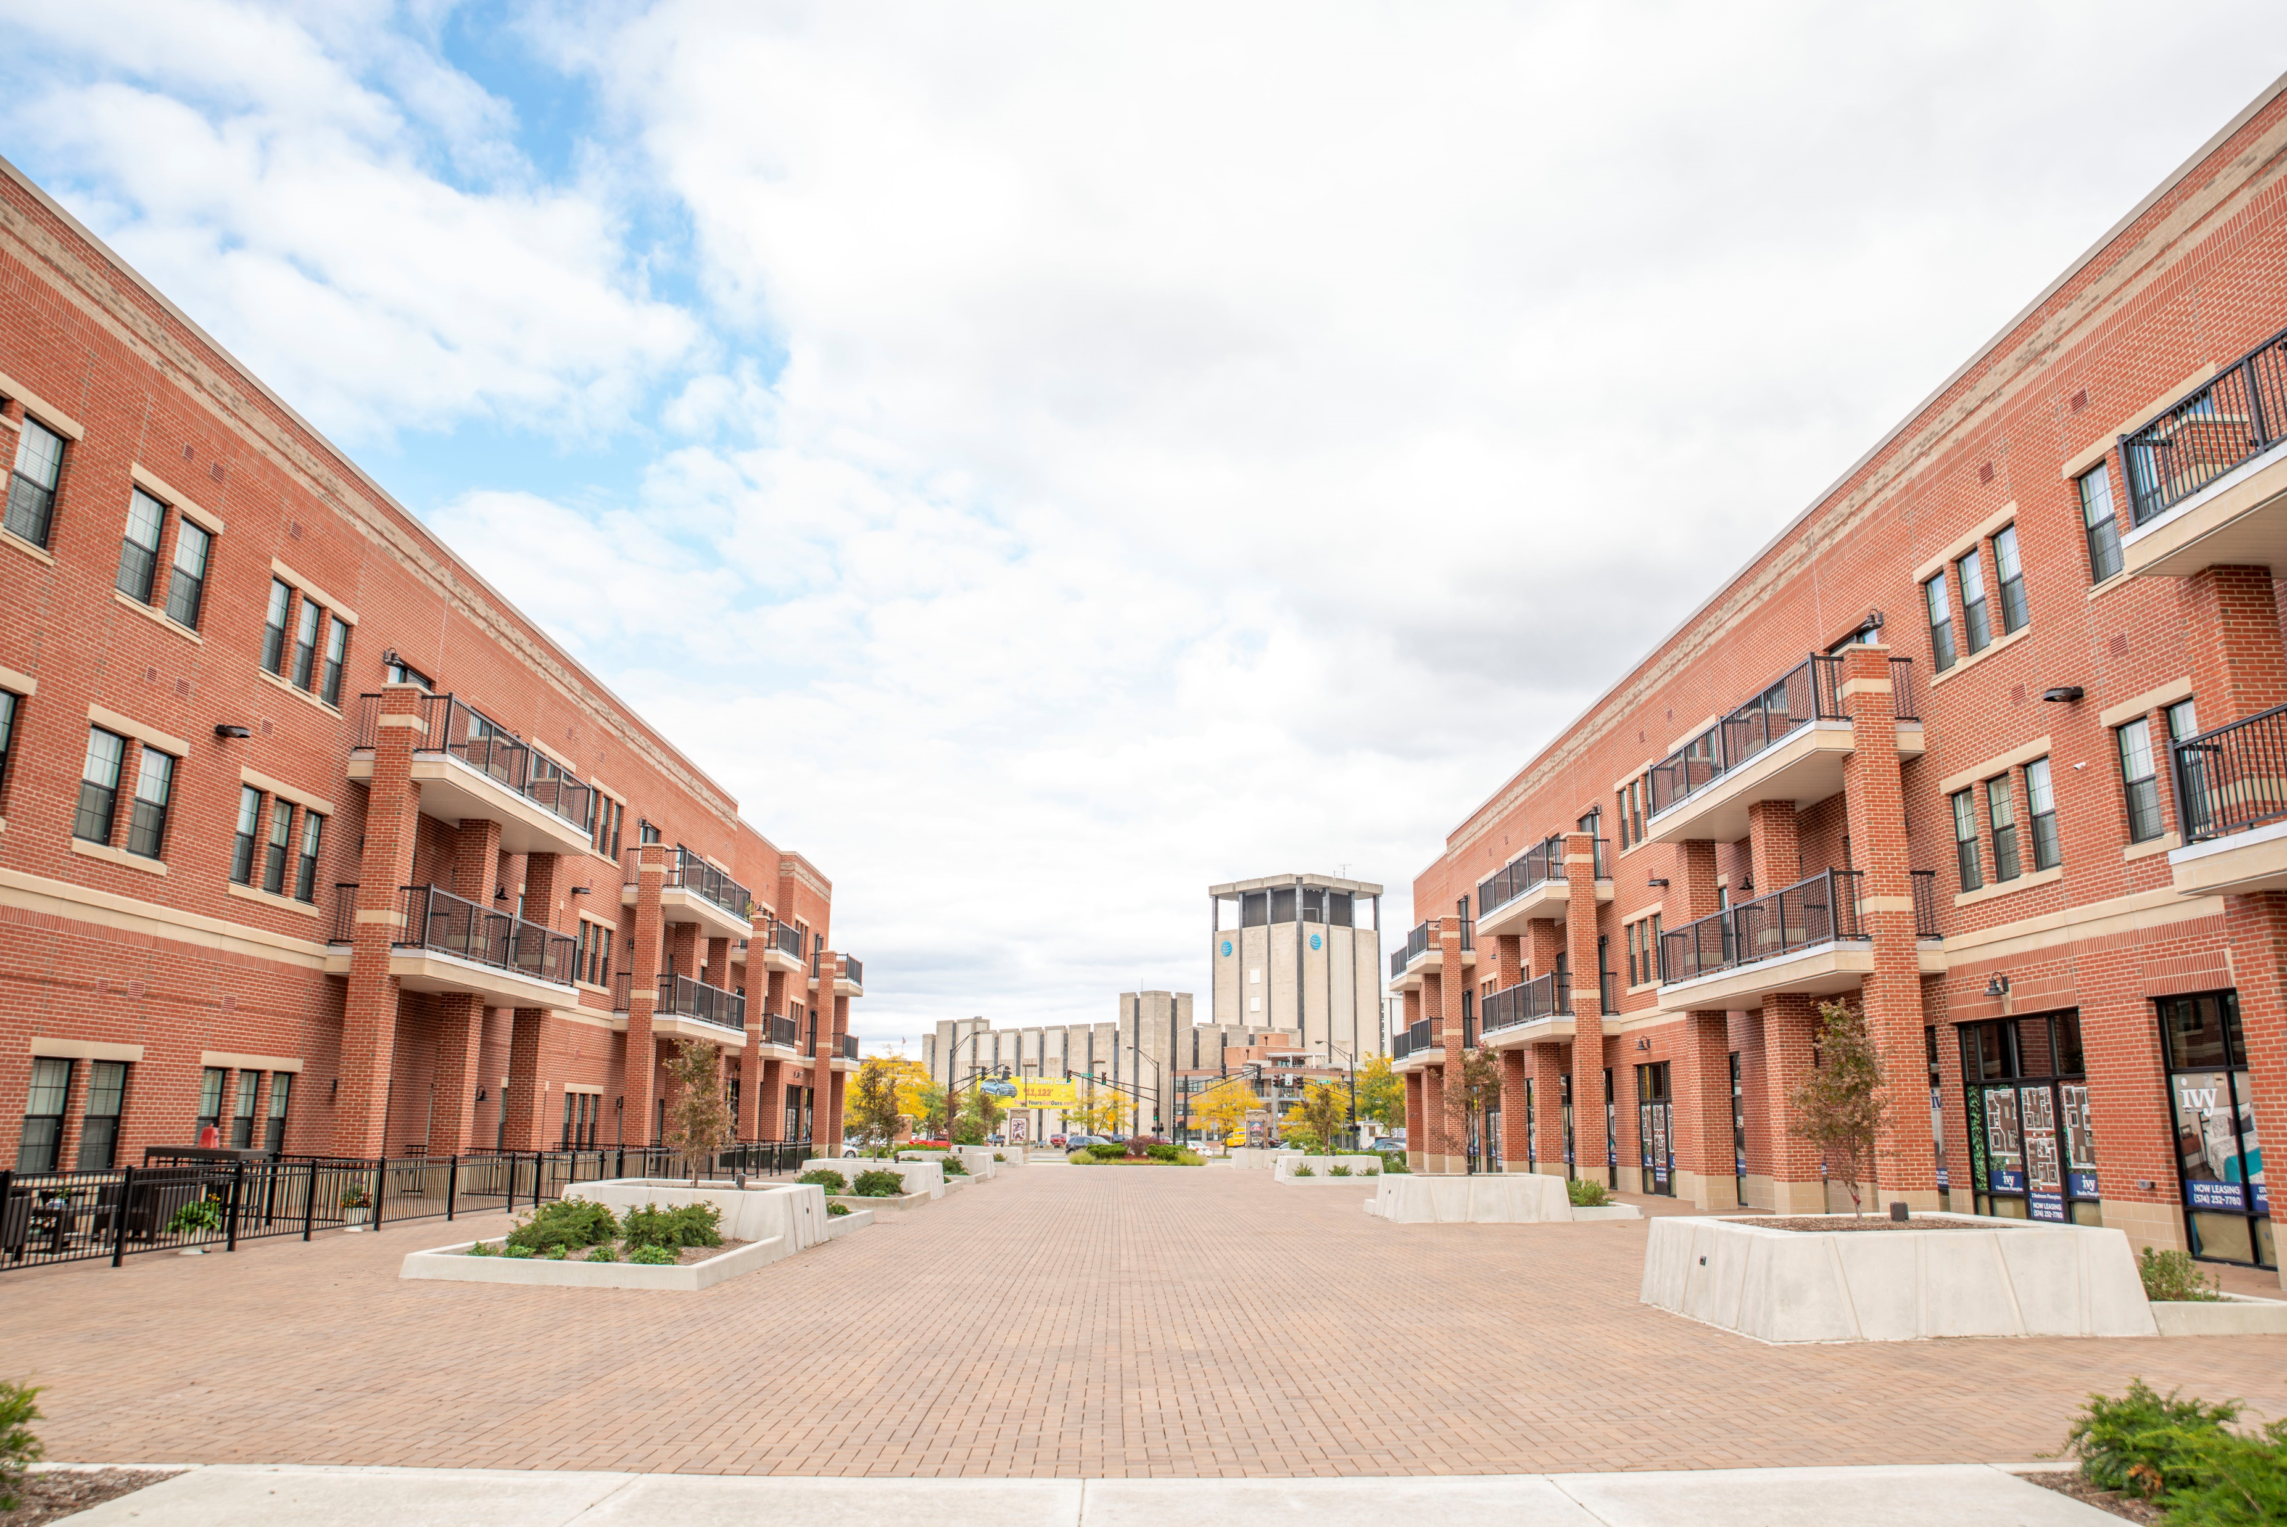
PAST Developments
Ivy at Berlin Place
WORKFORCE
South Bend, Indiana

Slide 7
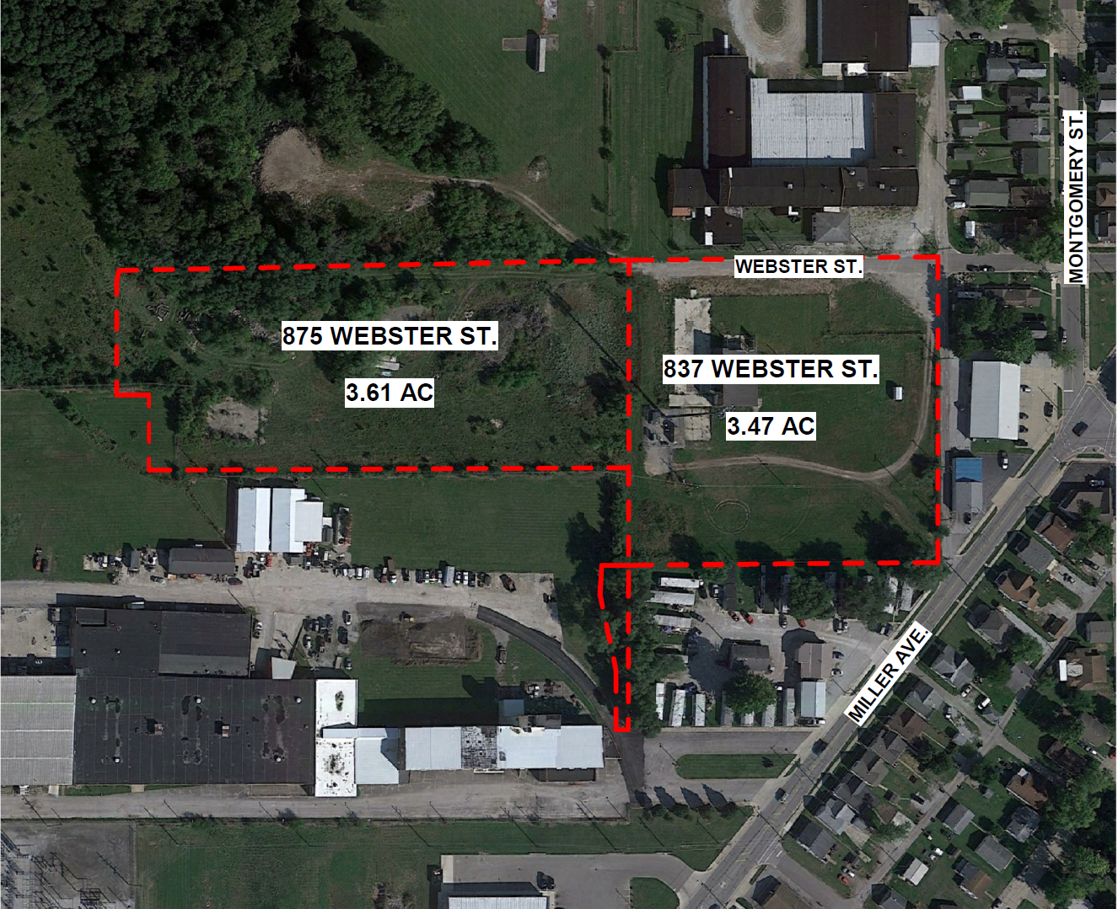
Our Proposed Development
Vacant, underutilized land in an area ripe for redevelopment
Workforce housing
138 Units
Mix of 1-, 2-, and 3-bedrooms
Current zoning: Industrial Light
Proposed zoning: Business General

Slide 8
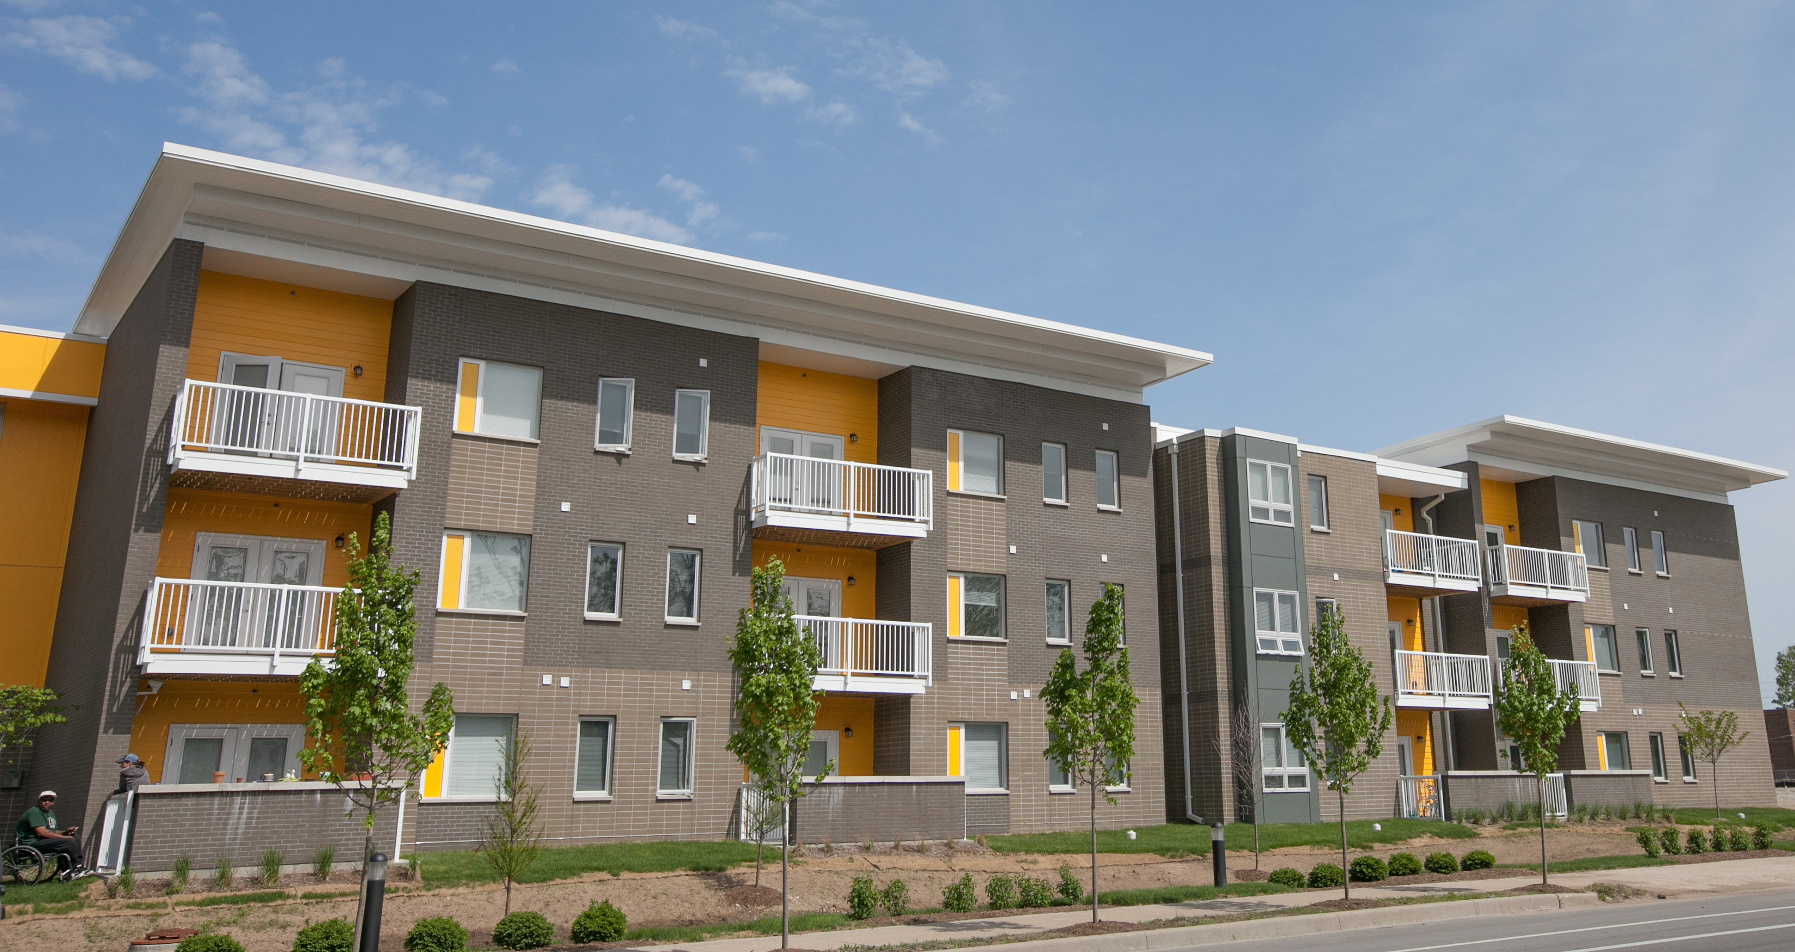
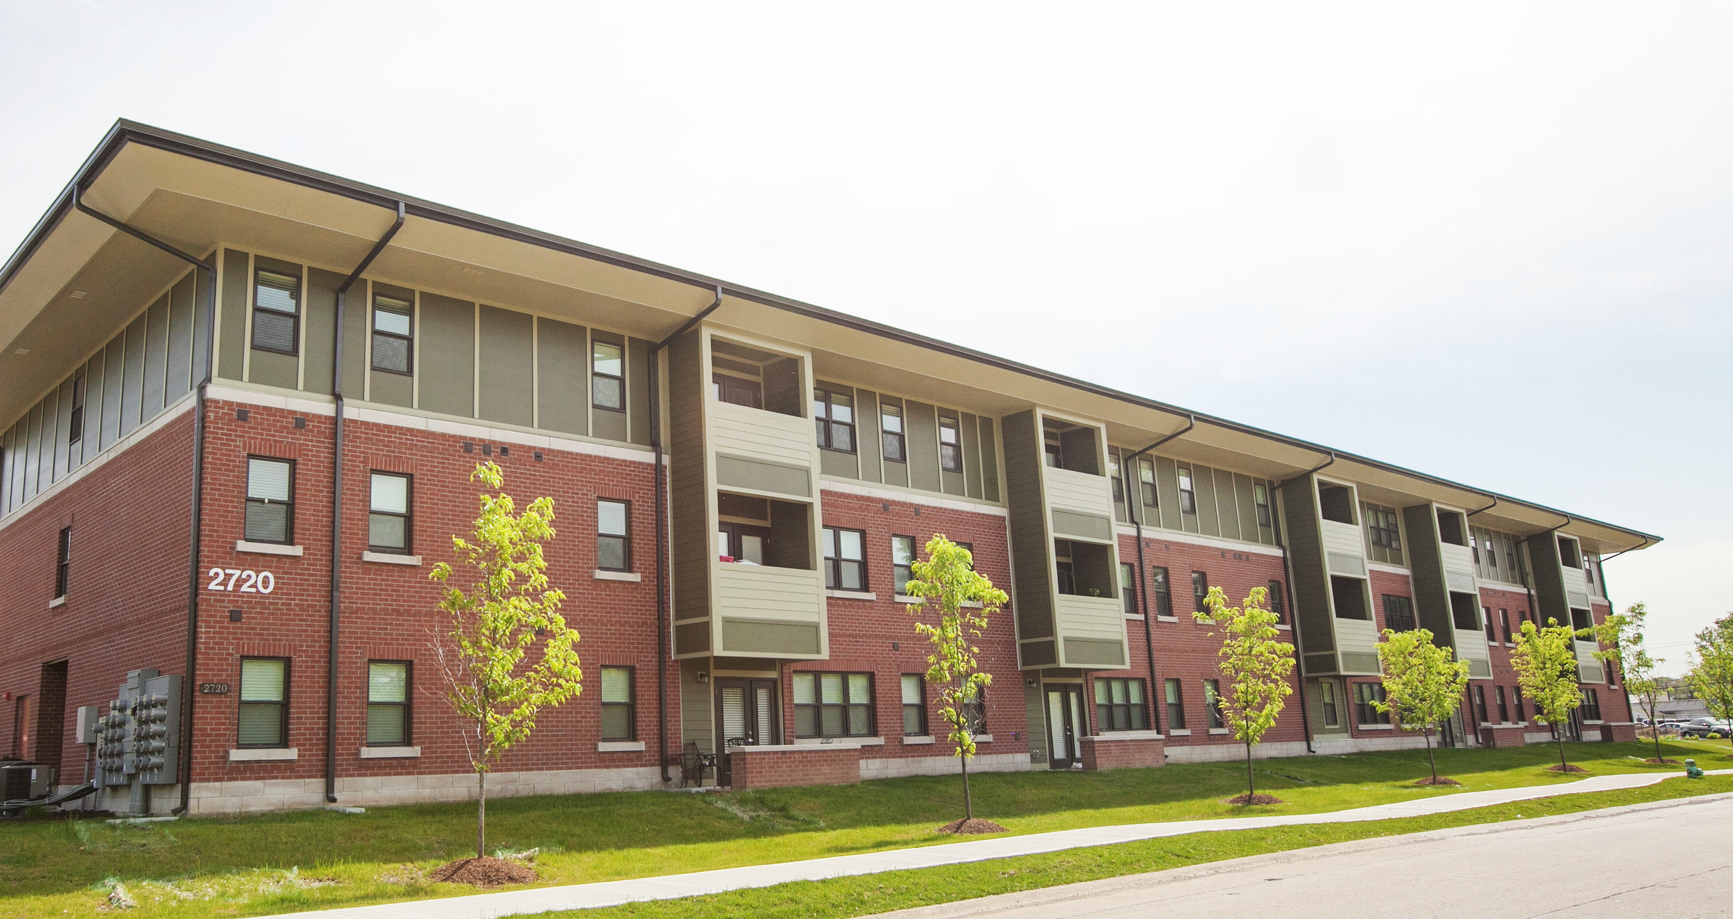
Location
Less than 1 mile to K-12 schools and Downtown Shelbyville
Close to the new West-Side Trail Connector
Easy access to many restaurants, stores, and community services
Unit Amenities
Energy Star Appliances
Ceiling Fans
LED Lighting
Programmable Thermostats
Dishwasher
In-Unit Laundry
Community Amenities
On-site Management & Maintenance
Clubhouse & Indoor Fitness Center
Playground
Dog Park
Bike Storage with Maintenance Area
Resident Events

Slide 9
Development Timeline
Rental Housing Tax Credit Application: July 3rd
Awards Announced: November 2023
Construction Begins: Spring/Summer 2024
Construction Ends: Fall 2025

Slide 10
Development contact
information
Marisa Conatser Development Director
mconatser@twgdev.com
(317) 656-1056
Notes:
Change date as needed

